Slide 1
Combinational Circuits:
Design Methods/Arithmetic Circuits
Introduction
Analysis Procedure
Design Methods
Gate-level (SSI) Design
  Half Adder
  Full Adder
  BCD-to-Excess-3 Code Converter
Block-Level Design
  4-bit Parallel Adder
  BCD-to-Excess-3 Code Converter
  16-bit Parallel Adder
  4-bit Parallel Adder cum Subtractor

Slide 2
Arithmetic Circuits
  Adders
  Parallel Adders
  Cascading Adders
  Parallel Adder-Subtractor
  Comparator
Calculations of Circuit Delays
Faster Circuits
Look-Ahead Carry Adder

Slide 3
Introduction
Two classes of logic circuits:
  combinational
  sequential
Combinational Circuit:
inputs
: :
Combinational
Logic
: :
outputs
Each output depends entirely on the immediate (present) inputs.

Slide 4
Introduction
Sequential Circuit: (to be covered later)
inputs
: :
Combinational
Logic
: :
outputs
Memory
Output depends on both present and past inputs.
Memory (via feedback loop) contains past information.

Slide 5
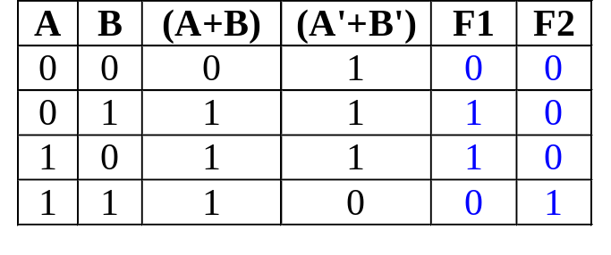
Analysis Procedure
Given a combinational circuit, can you analyze its function?
AB
A+B
F1
F2
= (A+B).(A'+B')
= (A'+B')' = A.B
A'+B'
Steps:
  1. Label the inputs and outputs.
  2. Obtain the functions of intermediate points and the outputs.
  3. Draw the truth table.
  4. Deduce the functionality of the circuit  half adder.

Slide 6
Design Methods
Different combinational circuit design methods:
  Gate-level method (with logic gates)
  Block-level design method
Design methods make use of logic gates and useful functional blocks.
  These are available as Integrated Circuit (IC) chips.

Slide 7
Design Methods
Type of IC chips (based on packing density) :
  Small-scale integration (SSI): up to 12 gates
  Medium-scale integration (MSI): 12-99 gates
  Large-scale integration (LSI): 100-9999 gates
  Very large-scale integration (VLSI): 10,000-99,999 gates
  Ultra large-scale integration (ULSI): > 100,000 gates
Main objectives of circuit design:
  (i) reduce cost
    reduce number of gates (for SSI circuits)
    reduce IC packages (for complex circuits)
  (ii) increase speed
  (iii) design simplicity (reuse blocks where possible)

Slide 8
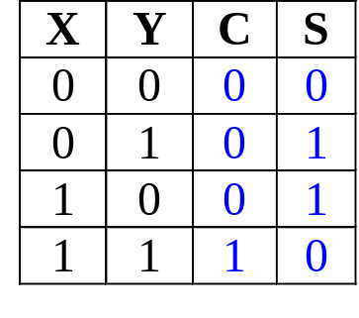
Gate-level (SSI) Design: Half Adder
Design procedure:
1) State Problem
Example: Build a Half Adder to add two bits
2) Determine and label the inputs & outputs of circuit.
Example: Two inputs and two outputs labelled, as follows:
X
Y
Half
Adder
S
C
(X + Y)
3) Draw truth table.

Slide 9
Gate-level (SSI) Design: Half Adder
4) Obtain simplified Boolean function.
Example: C = X.Y
S = X'.Y + X.Y' = X⊕Y
5) Draw logic diagram.
X
Y
S
Half Adder
C

Slide 10
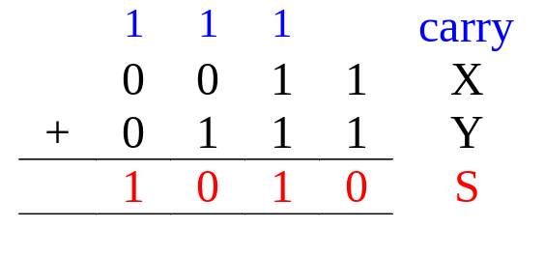
Gate-level (SSI) Design: Full Adder
Half-adder adds up only two bits.
To add two binary numbers, we need to add 3 bits (including the carry).
Example:
Need Full Adder (so called as it can be made from two half-adders).
X
Y
Z
Full
Adder
S
C
(X + Y + Z)

Slide 11
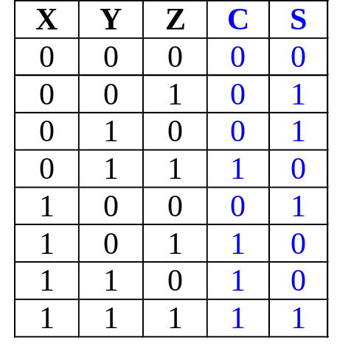
Gate-level (SSI) Design: Full Adder
Truth table:
Note:
  Z - carry in (to the current position)
  C - carry out (to the next position)
C
YZ
00 01 11 10
X
0
1
1
Using K-map, simplified SOP form:
C = X.Y + X.Z + Y.Z
S = X'.Y'.Z + X'.Y.Z'+X.Y'.Z'+X.Y.Z
1
1
1
S
YZ
00 01 11 10
X
0
1
1
1
1
1

Slide 12
Gate-level (SSI) Design: Full Adder
Alternative formulae using algebraic manipulation:
  C = X.Y + X.Z + Y.Z
  = X.Y + X (Y+Y ‘).Z + (X+X’)YZ
  = X.Y + X YZ+XY ‘Z + X YZ +X’YZ
  = X.Y (1+Z) + (X⊕Y).Z
  = X.Y + (X⊕Y).Z
  S = X'.Y'.Z + X'.Y.Z' + X.Y'.Z' + X.Y.Z
  = X‘.(Y'.Z + Y.Z') + X.(Y'.Z' + Y.Z)
  = X'.(Y⊕Z) + X.(Y⊕Z)'
  = X⊕(Y⊕Z) or (X⊕Y)⊕Z

Slide 13
Gate-level (SSI) Design: Full Adder
Circuit for above formulae:
  C = X.Y + (X⊕Y).Z
  S = (X⊕Y)⊕Z
X
Y
(X⊕Y)
S
(XY)
C
Z
Full Adder made from two Half-Adders (+ OR gate).

Slide 14
Gate-level (SSI) Design: Full Adder
Circuit for above formulae:
  C = X.Y + (X⊕Y).Z
  S = (X⊕Y)⊕Z
Block diagrams.
X
Y
X
Y
(X⊕Y)
Sum
X
Y
Sum
S
Half
Adder
Half
Adder
Carry
(X.Y)
Carry
C
Z
Full Adder made from two Half-Adders (+ OR gate).

Slide 15
Code Converters
Code converters – take an input code, translate to its equivalent output code.
Input
code
Code
converter
Output
code
Example: BCD to Excess-3 Code Converter.
Input: BCD digit
Output: Excess-3 digit

Slide 16
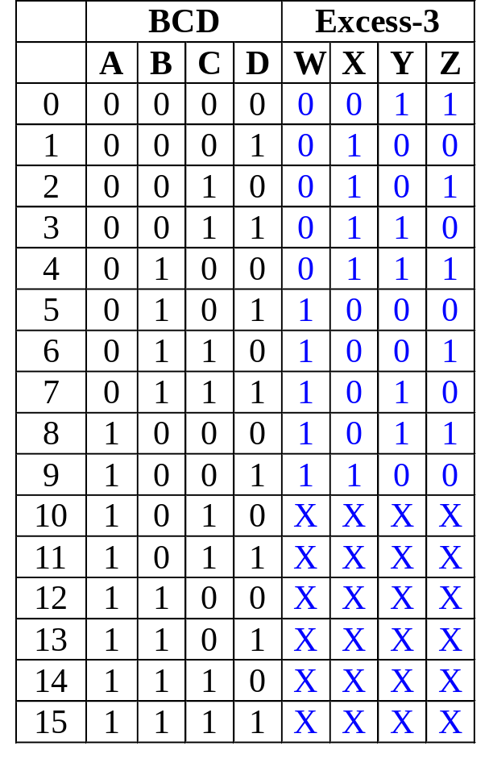
BCD-to-Excess-3 Code Converter
Truth table:
K-maps:
CD
C
CD
C
AB
00 01 11 10
AB
00 01 11 10
00
01
11
10
00
01
11
10
1
1
1
1
1
1
1
B
B
A
X
X
X
X
A
X
X
X
X
1
1
X
X
1
X
X
W
D
X
D
CD
C
CD
C
AB
00 01 11 10
AB
00 01 11 10
00
01
11
10
1
1
00
01
11
10
1
1
1
1
1
1
B
B
A
X
X
X
X
A
X
X
X
X
1
X
X
1
X
X
Y
D
Z
D

Slide 17
BCD-to-Excess-3 Code Converter
CD
C
CD
C
AB
00 01 11 10
AB
00 01 11 10
00
01
11
10
00
01
11
10
1
1
1
W = A + B.C + B.D
X = B'.C + B‘.D + B.C'.D'
Y = C.D + C'.D'
Z = D'
1
1
1
1
B
B
A
X
X
X
X
A
X
X
X
X
1
1
X
X
1
X
X
W
D
X
D
CD
C
CD
C
AB
00 01 11 10
AB
00 01 11 10
00
01
11
10
1
1
00
01
11
10
1
1
1
1
1
1
B
B
A
X
X
X
X
A
X
X
X
X
1
X
X
1
X
X
Y
D
Z
D

Slide 18
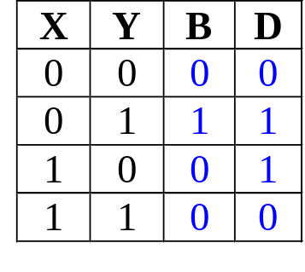

Gate-level (SSI) Design: Half Subtractor
1) Obtain simplified Boolean function.
Example: B = X’.Y
D = X'.Y + X.Y' = X⊕Y
2) Draw logic diagram.
X
Y
D
B

Slide 19

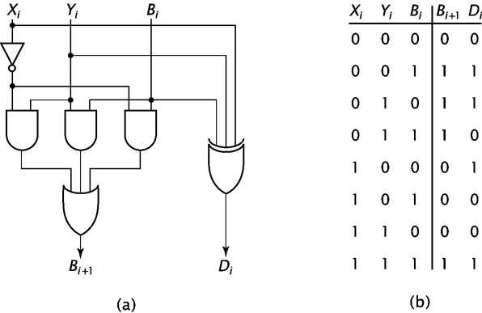
Full Subtractor
Full subtractor has 3 inputs
  Two data inputs
  One borrow input B_{i+1}=X_{i}’Y_{i}+X_{i}’B_{i}+Y_{i}B_{i}
        D_{i}=X_{i} Y_{i} B_{i}

Slide 20
Block-Level Design Method
More complex circuits can also be built using block-level method.
In general, block-level design method (as opposed to gate-level design) relies on algorithms or formulae of the circuit, which are obtained by decomposing the main problem to sub-problems recursively (until small enough to be directly solved by blocks of circuits).
Simple examples using 4-bit parallel adder as building blocks:
  (1) BCD-to-Excess-3 Code Conversion
  (2) 16-Bit Parallel Adder
  (3) Adder cum Subtractor

Slide 21
4-bit Parallel Adder
Consider a circuit to add two 4-bit numbers together and a carry-in, to produce a 5-bit result:
X₄
X₃
X₂
X₁
Y₄
Y₃
Y₂
Y₁
4-bit
Parallel Adder
C₅
C₁
Black-box view of 4-bit parallel adder
S₄
S₃
S₂
S₁
5-bit result is sufficient because the largest result is:
(1111)₂+(1111)₂+(1)₂ = (11111)₂

Slide 22
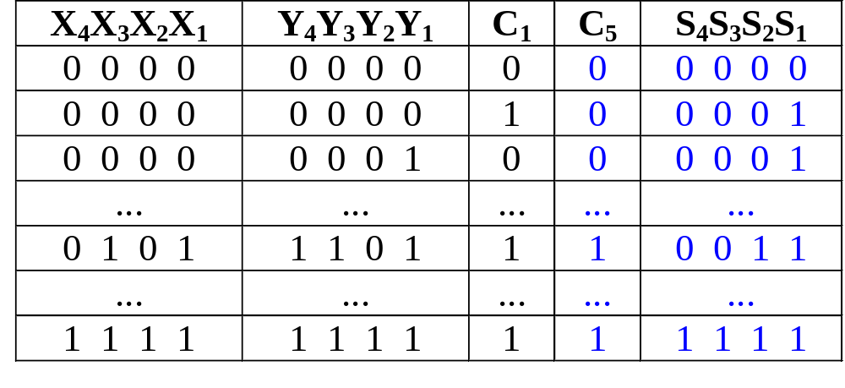
4-bit Parallel Adder
SSI design technique should not be used.
Truth table for 9 inputs very big, i.e. 2⁹=512 entries:
Simplification very complicated.

Slide 23
4-bit Parallel Adder
Alternative design possible.
Addition formulae for each pair of bits (with carry in),
C_{i+1}S_{i} = X_{i} + Y_{i} + C_{i}
has the same function as a full adder.
C_{i+1} = X_{i} .Y_{i} + (X_{i} ⊕ Y_{i} ) .C_{i}
S_{i} = X_{i} ⊕ Y_{i} ⊕ C_{i}

Slide 24
4-bit Parallel Adder
Cascading 4 full adders via their carries, we get:
Y₄ X₄
Y₃ X₃
Y₂ X₂
Y₁ X₁
C₄
C₃
C₂
C₅
FA
FA
FA
FA
C₁
S₄
S₃
S₂
S₁
Input
Output

Slide 25
Parallel Adders
Note that carry propagated by cascading the carry from one full adder to the next.
Called Parallel Adder because inputs are presented simultaneously (in parallel). Also, called Ripple-Carry Adder.

Slide 26
BCD-to-Excess-3 Code Converter
Excess-3 code can be converted from BCD code using truth table:
Gate-level design can be used since only 4 inputs.
However, alternative design possible.
Use problem-specific formulae:
Excess-3 Code
= BCD Code + (0011)₂

Slide 27
BCD-to-Excess-3 Code Converter
Excess-3 Code = BCD Code + (0011)₂
Block-level circuit:
unused
X₄
X₃
X₂
X₁
Cout
BCD
code
S₄
S₃
S₂
S₁
4-bit Parallel Adder
Excess-3
code
0
0
1
1
Y₄
Y₃
Y₂
Y₁
Cin
A BCD-to-Excess-3 Code Converter
0

Slide 28
16-bit Parallel Adder
Larger parallel adders can be built from smaller ones.
Example: a 16-bit parallel adder can be constructed from four 4-bit parallel adders:
X₁₆..X₁₃
Y₁₆..Y₁₃
X₁₂..X₉
Y₁₂..Y₉
X₈..X₅
Y₈..Y₅
X₄..X₁
Y₄..Y₁
4
4
4
4
4
4
4
4
C₁₇
4-bit // adder
C₁₃
4-bit // adder
C₉
4-bit // adder
C₅
4-bit // adder
C₁
4
4
4
4
S₁₆..S₁₃
S₁₂..S₉
S₈..S₅
S₄..S₁
A 16-bit parallel adder

Slide 29
16-bit Parallel Adder
Shortened notation for multiple lines.
4
is a shortened notation for
S₄ .. S₁
S₄ S₃ S₂ S₁
16-bit parallel adder ripples carry from one 4-bit block to the next.
Such ripple-carry circuits are “slow” because of long delays needed to propagate the carries.

Slide 30
4-bit Parallel Adder cum Subtractor
Subtraction can be performed through addition using 2s-complement numbers.
Hence, we can design a circuit which can perform both addition and subtraction, using a parallel adder.
X₄
X₃
X₂
X₁
Y₄
Y₃
Y₂
Y₁
4-bit adder
cum subtractor
S: control signal for add/subtract
Result: either X+Y or X-Y

Slide 31
4-bit Parallel Adder cum Subtractor
The control signal S=0 means add
S=1 means subtract
Recall that:
X-Y = X + (-Y)
= X + (2’s complement of Y)
= X + (1’s complement of Y) +1
X+Y = X + (Y)

Slide 32
4-bit Parallel Adder cum Subtractor
Design requires:
  (i) XOR gates:
Y
Y
Y
Y'
S = 0
S = 1
such that: output = Y when S=0
= Y' when S=1
  (ii) S connected to carry-in.

Slide 33
4-bit Parallel Adder cum Subtractor
Adder cum subtractor circuit:
Y₄
Y₃
Y₂
Y₁
S
X₄
X₃
X₂
X₁
C
Cout
4-bit
parallel adder
Cin
Analysis:
If S=1, then
X + (1's complement of Y) +1
appears as the result.
If S=0, then X+Y appears as
the result.
S₄
S₃
S₂
S₁
A 4-bit adder cum subtractor

Slide 34
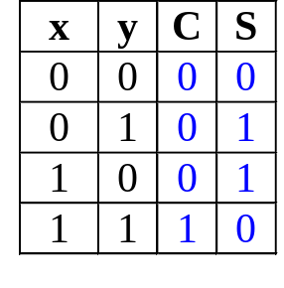
Arithmetic Circuits: Adders
Revision
Half adder
Σ
Input bits
X
Σ
Sum
Output bits
Y
Cout
Carry
x
y'
x'
y'
x'
y
S = xy' + x'y
x
y
S = (C+x'y')'
C
x
y
C
x
y
x
y
S = x ⊕ y
x'
y'
S = (x+y)(x'+y')
C
x
y
C

Slide 35
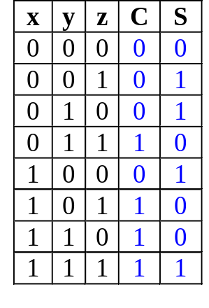
Arithmetic Circuits: Adders
Revision
Full adder
Σ
A
Σ
Sum
Input bits
Output bits
B
Cout
Carry
Cin
yz
00 01 11 10
yz
00 01 11 10
X'
y'
z
x
x
0
1
1
0
1
1
1
x'
y
z'
1
1
1
1
1
S
C = xy + xz + yz
S = x'y'z + x'yz' + xy'z' + xyz
x
y'
z'
x
y
z
x⊕y
x
y
S = (x⊕y)⊕z
x
y
xy
x
z
C = xy + (x⊕y)z
C
z
y
z

Slide 36
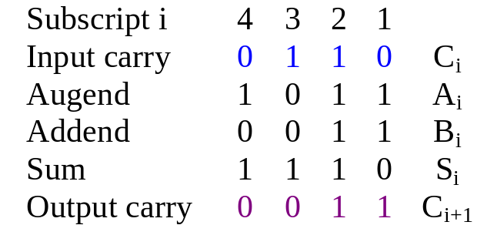
Arithmetic Circuits: Parallel Adders
Revision
Example: Adding two 4-bit numbers
2 ways:
  Serial (one FA)
  Parallel (n FAs for n bits)
Y₄ X₄
Y₃ X₃
Y₂ X₂
Y₁ X₁
C₄
C₃
C₂
C₅
FA
FA
FA
FA
C₁
Binary no. A
Σ
X
4-bit sum
S₄
S₃
S₂
S₁
S
Binary no. B
Y
Cout
Output carry
Input carry
Cin

Slide 37
Arithmetic Circuits: Cascading Adders
Revision
4-bit parallel adder:
  cascade 4 full adders
  classical method: 9 input variables  2⁹ = 512 rows in truth table!
Cascading method can be extended to larger numbers, example: 16-bit parallel adder.
X₁₆..X₁₃
Y₁₆..Y₁₃
X₁₂..X₉
Y₁₂..Y₉
X₈..X₅
Y₈..Y₅
X₄..X₁
Y₄..Y₁
4
4
4
4
4
4
4
4
C₁₇
4-bit // adder
C₁₃
4-bit // adder
C₉
4-bit // adder
C₅
4-bit // adder
C₁
4
4
4
4
S₁₆..S₁₃
S₁₂..S₉
S₈..S₅
S₄..S₁

Slide 38
Arithmetic Circuits: Adder-Subtractor
Revision
Make use of 2’s complement:
X - Y = X + (-Y)
2’s complement of Y = Inverting bits in Y and plus 1.
Y₄
Y₃
Y₂
Y₁
S
X₄
X₃
X₂
X₁
Z_{i} = S.Y_{i}' + S'.Y_{i}
Z₄
Z₃
Z₂
Z₁
4-bit
parallel adder
When S=0,
Cin=0, Z_{i} = Y_{i} → S = X + Y
When S=1,
Cin=1, Z_{i} = Y_{i}' → S = X + Y' + 1
C
Cout
Cin
S₄
S₃
S₂
S₁

Slide 39
Comparators
A comparator compares two n-bit values to determine which is greater, or if they are equal.

Slide 40
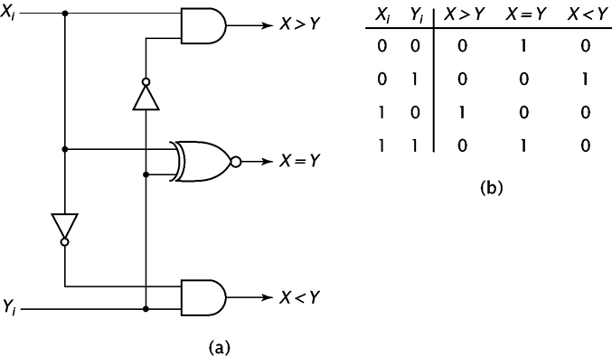
1-bit Comparator

Slide 41
Extending to Multibit Numbers
Compare the most significant bits.
  If they are not equal, no need to compare the other bits.
  If they are equal, we must check the next bit.
Continue until one number if found to be greater than the other, or all bits are checked and the numbers are found equal.

Slide 42
Arithmetic Circuits: Comparator
Magnitude comparator: compares 2 values A and B, to see if A>B, A=B or A<B.
Classical method requires 2^{2n} rows in truth table!
How do we compare two 4-bit values A (a₃a₂a₁a₀) and B (b₃b₂b₁b₀)?
If (a₃ > b₃) then A > B
If (a₃ < b₃) then A < B
If (a₃ = b₃) then if (a₂ > b₂) ….

Slide 43
Arithmetic Circuits: Comparator
Let A = A₃A₂A₁A₀ , B = B₃B₂B₁B₀; x_{i} = A_{i}.B_{i} + A_{i}'.B_{i}'
A₃
x₃
A₃'.B₃
B₃
A₃.B₃'
A₃'.B₃ + x₃.A₂'.B₂
+ x₃.x₂.A₁'.B₁
+ x₃. x₂.x₁.A₀'.B₀
A₂
x₂
B₂
(A < B)
A₁
x₁
B₁
A₃.B₃' + x₃.A₂.B₂'
+ x₃.x₂.A₁.B₁'
+ x₃. x₂.x₁.A₀.B₀'
A₀
x₀
(A > B)
B₀
(A = B)
x₃. x₂.x₁.x₀

Slide 44
Arithmetic Circuits: Comparator
0
1
1
0
A₃
A₂
A₁
A₀
4-bit comp
1
0
1
0
B₃
B₂
B₁
B₀
(A < B)
1
0
0
(A > B)
(A = B)
Block diagram of a 4-bit magnitude comparator

Slide 45
Calculation of Circuit Delays
In general, given a logic gate with delay, t.
t₁
t₂
Logic
Gate
:
:
t_{n}
max (t₁, t₂, ..., t_{n} ) + t
If inputs are stable at times t₁,t₂,..,t_{n}, respectively; then the earliest time in which the output will be stable is:
max(t₁, t₂, .., t_{n}) + t
To calculate the delays of all outputs of a combinational circuit, repeat above rule for all gates.

Slide 46
Calculation of Circuit Delays
As a simple example, consider the full adder circuit where all inputs are available at time 0. (Assume each gate has delay t.)
X
Y
0
max(0,0)+t = t
max(t,0)+t = 2t
0
S
t
2t
max(t,2t)+t = 3t
C
Z
0
where outputs S and C, experience delays of 2t and 3t, respectively.

Slide 47
Calculation of Circuit Delays
More complex example: 4-bits parallel adder.
Y₄ X₄
Y₃ X₃
Y₂ X₂
Y₁ X₁
C₄
C₃
C₂
0
0
0
0
0
0
0
0
0
C₅
FA
FA
FA
FA
C₁
S₄
S₃
S₂
S₁

Slide 48
Calculation of Circuit Delays
Analyse the delay for the repeated block:
0
where X_{i}, Y_{i} are stable at 0t, while C_{i} is assumed to be stable at mt.
X_{i}
Y_{i}
C_{i}
S_{i}
C_{i+1}
0
Full
Adder
mt
Performing the delay calculation gives:
X_{i}
Y_{i}
0
max(0,0)+t = t
max(t,mt)+t
0
S_{i}
t
max(t,mt)+t
max(t,mt)+2t
C_{i+1}
C_{i}
mt

Slide 49
Calculation of Circuit Delays
Calculating:
When i=1, m=0: S₁ = 2t and C₂ = 3t.
When i=2, m=3: S₂ = 4t and C₃ = 5t.
When i=3, m=5: S₃ = 6t and C₄ = 7t.
When i=4, m=7: S₄ = 8t and C₅ = 9t.
In general, an n-bit ripple-carry parallel adder will experience:
S_{n} = ((n-1)*2+2)t
C_{n+1} = ((n-1)*2+3)t
as their delay times.
Propagation delay of ripple-carry parallel adders is proportional to the number of bits it handles.
Maximum Delay: ((n-1)*2+3)t

Slide 50
Faster Circuits
Three ways of improving the speed of these circuits:
  (i) Use better technology (e.g. ECL faster than TTL gates), BUT
    faster technology is more expensive, needs more power, lower-level of integrations.
  (ii) Use gate-level designs to two-level circuits! (use sum- of-products/product-of-sums) BUT
    (a) complicated designs for large circuits.
    (b) product/sum terms need MANY inputs!
  (iii) Use look-ahead techniques BUT there are additional costs

Slide 51
Look-Ahead Carry Adder
Consider the full adder:
where intermediate signals are labelled as P_{i}, G_{i}, and defined as:
P_{i} = X_{i}⊕Y_{i}
G_{i} = X_{i}.Y_{i}
X_{i}
Y_{i}
P_{i}
S_{i}
G_{i}
C_{i+1}
C_{i}
The outputs, C_{i+1},S_{i}, in terms of P_{i} ,G_{i} ,C_{i} , are:
S_{i} = P_{i} ⊕ C_{i} …(1)
C_{i+1} = G_{i} + P_{i}.C_{i} …(2)
If you look at equation (2),
G_{i} = X_{i}.Y_{i} is a carry generate signal
P_{i} = X_{i} ⊕ Y_{i} is a carry propagate signal

Slide 52
Look-Ahead Carry Adder
For 4-bit ripple-carry adder, the equations to obtain four carry signals are:
C_{i+1} = G_{i} + P_{i}.C_{i}
C_{i+2} = G_{i+1} + P_{i+1}.C_{i+1}
C_{i+3} = G_{i+2} + P_{i+2}.C_{i+2}
C_{i+4} = G_{i+3} + P_{i+3}.C_{i+3}
These formula are deeply nested, as shown here for C_{i+2}:
C_{i}
P_{i}
C_{i+1}
G_{i}
P_{i+1}
C_{i+2}
G_{i+1}
4-level circuit for C_{i+2} = G_{i+1} + P_{i+1}.C_{i+1}

Slide 53
Look-Ahead Carry Adder
Nested formula/gates cause ripple-carry propagation delay.
Can reduce delay by expanding and flattening the formula for carries. For example, C_{i+2}
C_{i+2} = G_{i+1} + P_{i+1}.C_{i+1}
= G_{i+1} + P_{i+1}.(G_{i} + P_{i}.C_{i} )
= G_{i+1} + P_{i+1}.G_{i} + P_{i+1}.P_{i}.C_{i}
New faster circuit for C_{i+2}
C_{i}
P_{i}
P_{i+1}
G_{i}
C_{i+2}
P_{i+1}
G_{i+1}

Slide 54
Look-Ahead Carry Adder
Other carry signals can also be similarly flattened.
C_{i+3}= G_{i+2} + P_{i+2}C_{i+2}
= G_{i+2} + P_{i+2}(G_{i+1} + P_{i+1}G_{i} + P_{i+1}P_{i}C_{i})
= G_{i+2} + P_{i+2}G_{i+1} + P_{i+2}P_{i+1}G_{i} + P_{i+2}P_{i+1}P_{i}C_{i}
C_{i+4} = G_{i+3} + P_{i+3}C_{i+3}
= G_{i+3} + P_{i+3}(G_{i+2} + P_{i+2}G_{i+1} + P_{i+2}P_{i+1}G_{i} + P_{i+2}P_{i+1}P_{i}C_{i})
= G_{i+3} + P_{i+3}G_{i+2} + P_{i+3}P_{i+2}G_{i+1} + P_{i+3}P_{i+2}P_{i+1}G_{i} + P_{i+3}P_{i+2}P_{i+1}P_{i}C_{i}
Notice that formulae gets longer with higher carries.
Also, all carries are two-level “sum-of-products” expressions, in terms of the generate signals, Gs, the propagate signals, Ps, and the first carry-in, C_{i}.

Slide 55
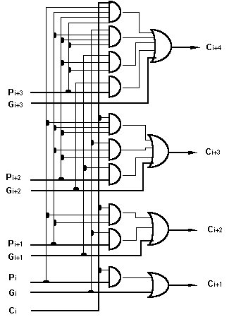
Look-Ahead Carry Adder
We employ the look-ahead formula in this lookahead-carry adder circuit:

Slide 56
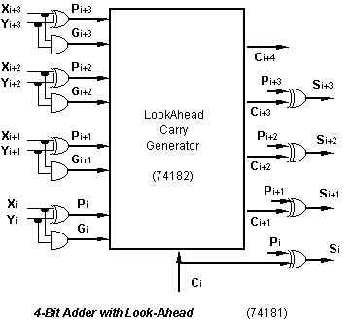
Look-Ahead Carry Adder
The 74182 IC chip allows faster lookahead adder to be built.
Maximum propagation delay is 4t (t to get generate & propagate signals, 2t to get the carries and t for the sum signals) where t is the average gate delay.

Slide 57
BCD ADDER

Slide 58
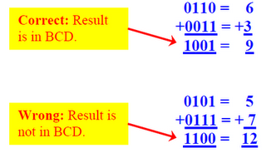
BCD Adder
If two BCD digits are added then their sum result will not always be in BCD.
Consider the two given examples.

Slide 59
In the first example, result is in BCD while in the second example it is not in BCD.
Four bits are needed to represent all BCD digits (0 – 9). But with four bits we can represent up to 16 values (0000 through 1111).
The extra six values (1010 through 1111) are not valid BCD digits.
Whenever the sum result is > 9, it will not be in BCD and will require correction to get a valid BCD result.

Slide 60
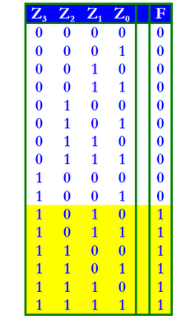
Correction is done through the addition of 6 to the result to skip the six invalid values as shown in the truth table by yellow color.

Slide 61
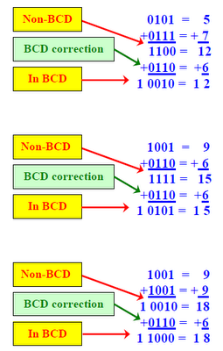
Consider the given examples of non-BCD sum result and its correction.

Slide 62
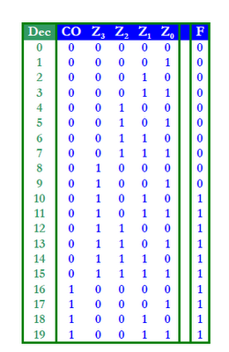
The maximum sum result of a BCD input adder can be 19. As maximum number in BCD is 9 and may be there will be a carry from previous stage also, so 9 + 9 + 1 = 19 .
The following truth table shows all the possible sum results when two BCD digits are added.

Slide 63
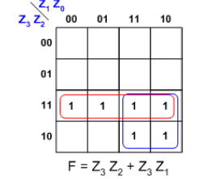
Values greater than 1111, i.e., from 10000 through 10011 (decimal 16 through 19) can be detected by the carry out (CO) which equals 1 only for these output values. So, F = CO = 1 for these values. Hence, F is true when CO is true OR when (Z₃ Z₂ + Z₃ Z₁) is true.
Thus, the correction step (adding 0110) is performed if the following function equals 1:
F = CO + Z₃ Z₂ + Z₃ Z₁

Slide 64
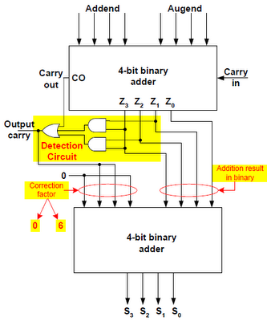

Slide 65
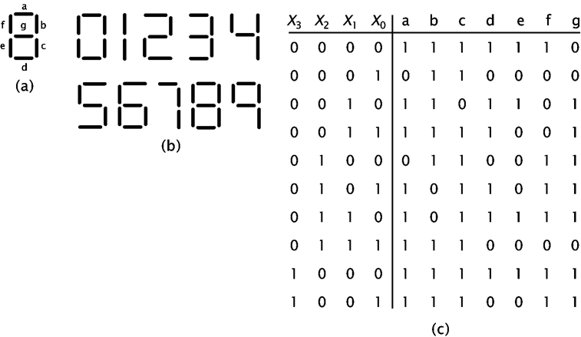
BCD to 7-Segment Decoder( SELF STUDY)
Converts the binary representation of a decimal digit, 0000 to 1001, to the signal needed to show the digit of a 7segment LED display.

Slide 66
Design
This circuit is seven distinct circuits, one for each segment.
For each segment we create a K-map, construct the minimal Boolean expression and the logic diagram.

Slide 67
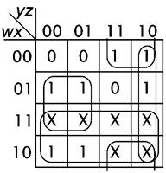
a segment
a = w + xy’ + x’y + yz’

Slide 68
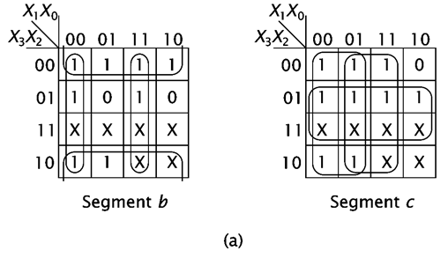
b and c segments
b = X₂’ + X₁’X₀’+X₁X₀ c = X₂ + X₁’ + X₀

Slide 69
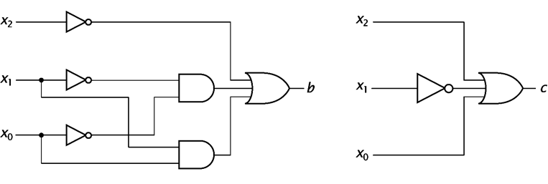
Diagrams
b = X₂’ + X₁’X₀’+X₁X₀
c = X₂ + X₁’ + X₀

Slide 70
Encoder
Encoding is the converse of decoding.
Given a set of input lines, where one has been selected, provide a code corresponding to that line.
Contains 2^{n} (or fewer) input lines and n output lines.
Implemented with OR gates.
An example:
F₀
D₀
Select via switches
F₁
4-to-2 Encoder
F₂
2-bits code
F₃
D₁

Slide 71
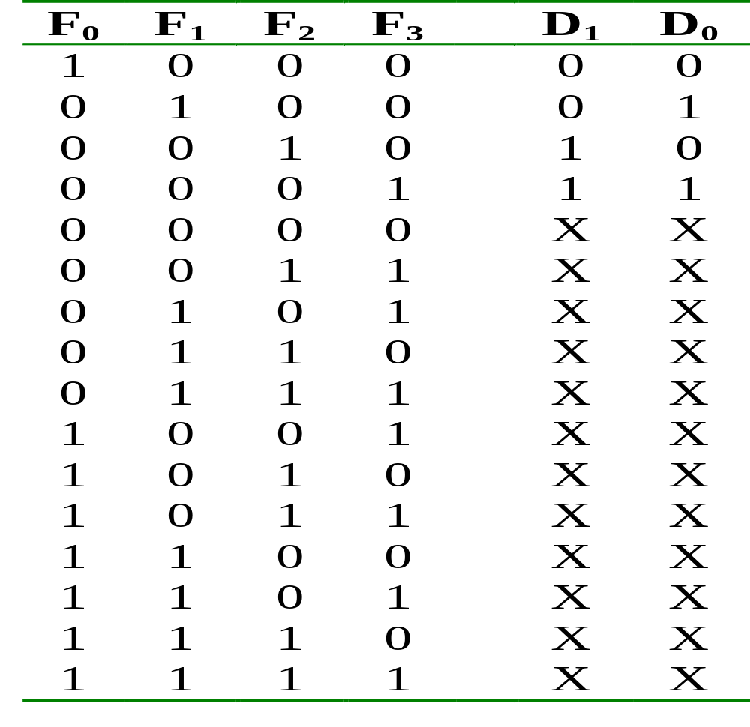
Encoder
Truth table:

Slide 72
Encoder
With the help of K-map (and don’t care conditions), can obtain:
D₀ = F1 + F3
D₁ = F2 + F3
which correspond to circuit:
F₀
F₁
D₀
Simple 4-to-2 encoder
F₂
F₃
D₁

Slide 73
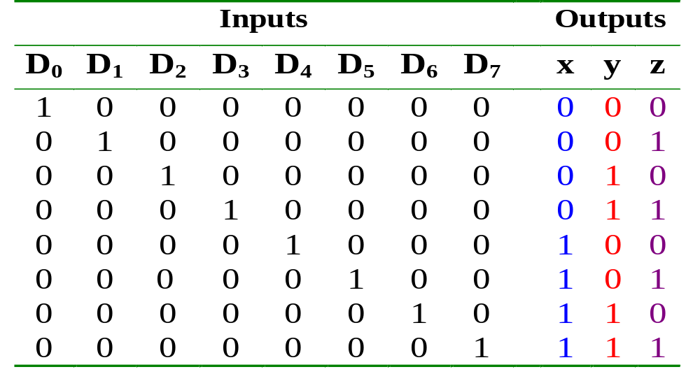
Encoder
Example: Octal-to-binary encoder.
  At any one time, only one input line has a value of 1.

Slide 74
Encoder
Example: Octal-to-binary encoder.
D₀
D₁
D₂
D₃
D₄
D₅
D₆
D₇
x = D₄ + D₅ + D₆ + D₇
y = D₂ + D₃ + D₆ + D₇
z = D₁ + D₃ + D₅ + D₇
Exercise: Can you design a 2^{n}-to-n encoder without the K-map?

Slide 75
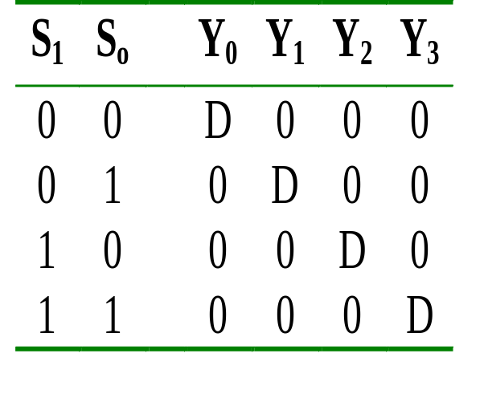
Demultiplexer
Given an input line and a set of selection lines, the demultiplexer will direct data from input to a selected output line.
An example of a 1-to-4 demultiplexer:
Outputs
Y₀ = D.S₁'.S₀'
Y₁ = D.S₁'.S₀
Data D
demux
Y₂ = D.S₁.S₀'
Y₃ = D.S₁.S₀
S₁ S₀
select

Slide 76
Demultiplexer
The demultiplexer is actually identical to a decoder with enable, as illustrated below:
Y₀ = D.S₁'.S₀'
2x4 Decoder
S₁
S₀
Y₁ = D.S₁'.S₀
Y₂ = D.S₁.S₀'
E
Y₃ = D.S₁.S₀
D
Exercise: Provide the truth table for above demultiplexer.

